Slide 1
QF602: Derivatives
Lecture 3: Options Strategies

Slide 2
Option Strategies
We will look at the payoff of different portfolios of stocks and options in this lecture.
The portfolios is also called option strategies.
They are used to express trader’s view of the future of the underlying (i.e. speculation) or for hedging.

Slide 3
Option Strategies
Protective Put
Covered Call
Bull spread
Bear spread
Butterfly spread
Condor spread
Ratio Spread
Straddle
Strangle

Slide 4
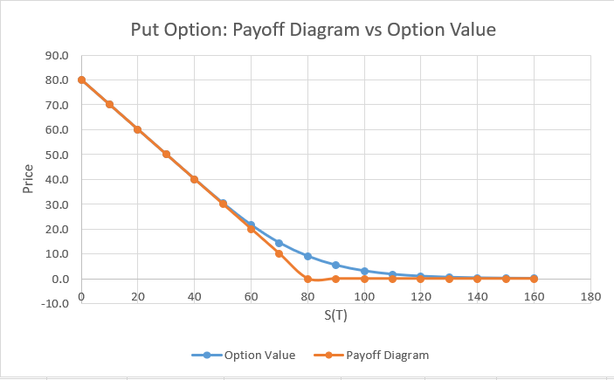
Payoff Diagram vs Option value
Let Put(t,T,K) be the value of an European put option with strike K at time t.
The payoff of an European put option can be represented as Put(T,T,K), i.e. the intrinsic value.

Slide 5
Protective Put
A portfolio consists of a put option and the underlying stock.
Long protective put is equivalent to holding a stock and a put option on the same stock.
The main motivation for buying a protective put is mainly for hedging.

Slide 6
Protective Put
A fund manager holds 10,000 stocks of IBM at $80.
The stock is trading at $90.
He is worried about the market going down during the next 3 months but doesn’t want to sell his shares.
The fund manager decides to buy 10,000 3-month European puts on IBM with strike at $80.
Buying a protective put enables an investor to fix the maximum loss that he could potentially suffer.

Slide 7
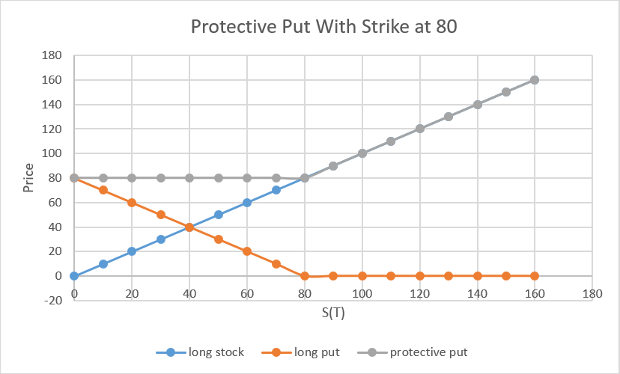
Payoff Diagram for Protective Put
Note that the premium of the option is not included in the payoff diagram.

Slide 8
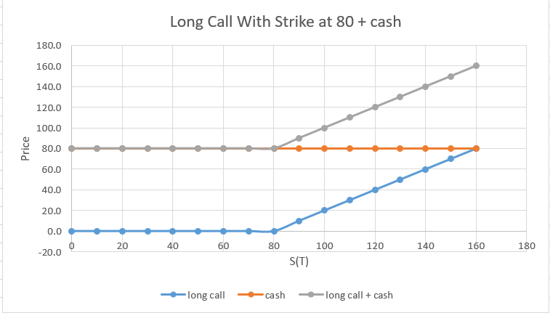
Equivalent to Call + Cash
Applying put-call parity, we can show that
Put(T,T,K) + S(T) = Call(T,T,K) + K

Slide 9
Covered Call
A portfolio consists of a call option and short selling the underlying stock.
The payoff of a covered call is
Covered Call(T,T,K) = Call(T,T,K) – S(T)
Writing a covered call is a popular hedging strategy.
A trader holds some shares and believes the price will increase in the long term but decline in the short term.
The trader will receive an extra income in the form of call option premium.

Slide 10
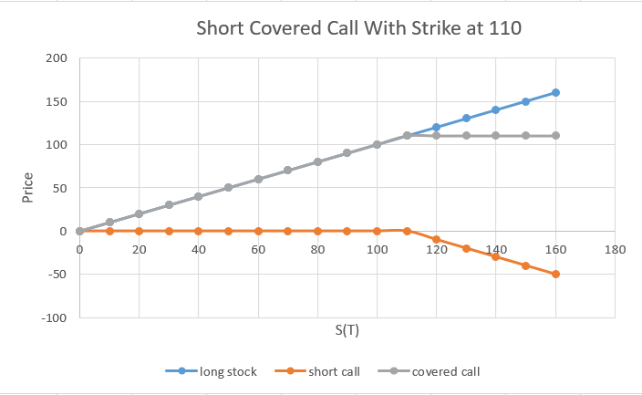
Payoff Diagram for Short Covered Call
The trader “gives up” the upside above 110 until the maturity of the option.
To compensate the potential expected short term stock price decrease.

Slide 11
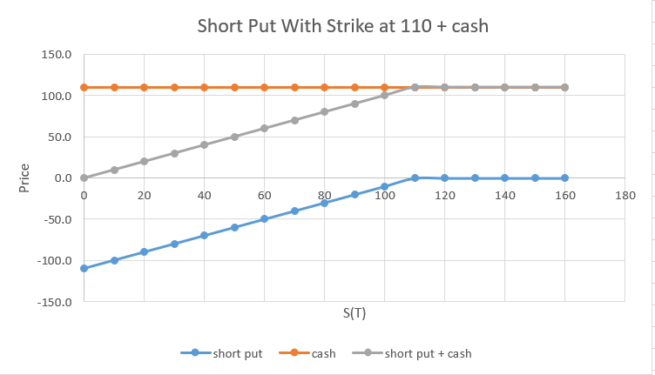
Equivalent to Short Put plus Cash
We can show that writing a covered call is equivalent to short a put plus cash:
S(T) - Call(T,T,K) = Put(T,T,K) + K

Slide 12
Bull Spreads
Bull spreads (or call spreads) are one of the most popular strategies and corresponding to a bullish view on the market.
Trader believes an asset is going to increase above a specific strike K1 but will not be able to reach a level K2, K1<K2.
Bull Spreads(T,T,K1,K2) = Call(T,T,K1) – Call(T,T,K2)

Slide 13
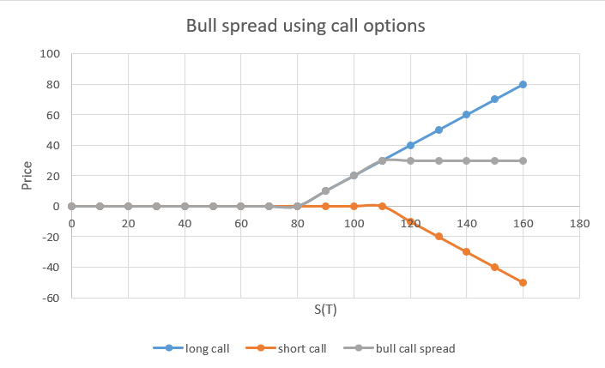
Payoff Diagram of Bull Spreads

Slide 14
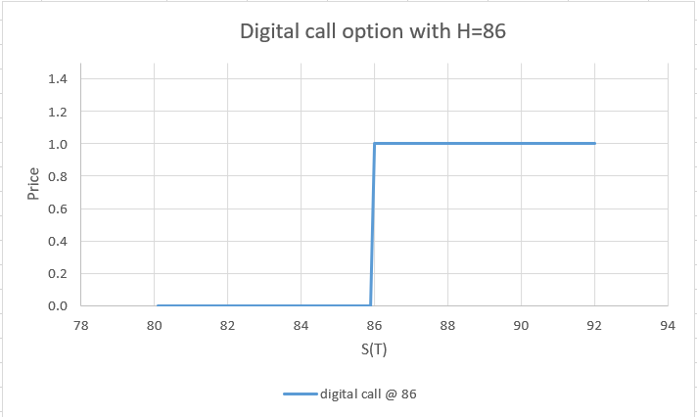
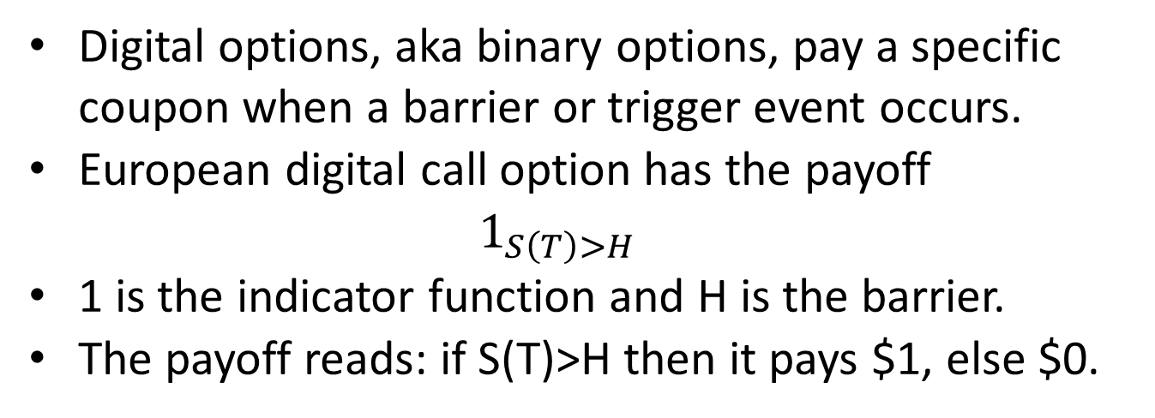
Digital Call Option
Digital options, aka binary options, pay a specific coupon when a barrier or trigger event occurs.
European digital call option has the payoff
$$1_{S\left(T\right)>H}$$
1 is the indicator function and H is the barrier.
The payoff reads: if S(T)>H then it pays $1, else $0.

Slide 15
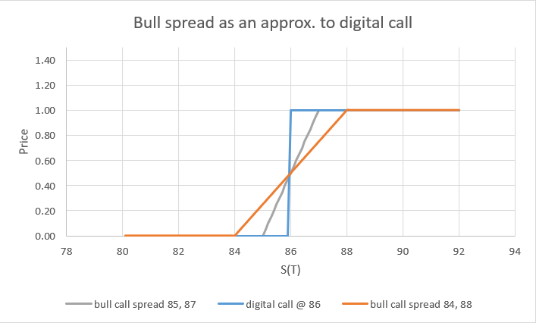
Bull Spread vs Digital Call
We can see the similarity between bull spread and digital call.
In fact, some banks use bull spread to price digital call.

Slide 16
Bear Spreads
Similar to bull spread but is for expressing a bearish view on the market.
Trader believes an asset is going to decrease below a specific strike K2 but will not be able to reach below a level K1, K1<K2.
Bear Spreads(T,T,K1,K2) = Put(T,T,K2) – Put(T,T,K1)

Slide 17
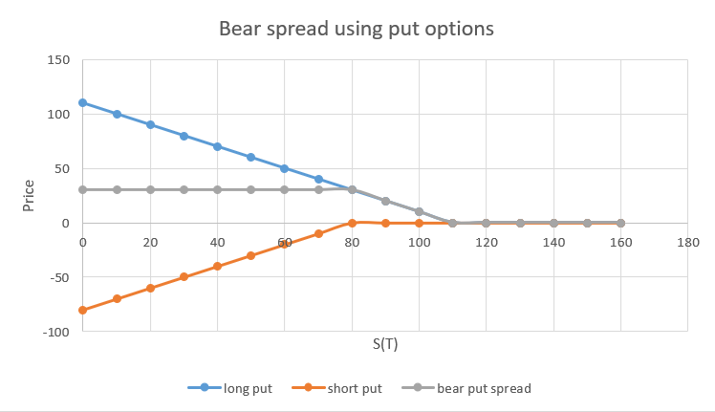
Payoff Diagram of Bear Spreads

Slide 18
Butterfly Spreads
It is considered to be a neutral strategy, neither bullish or bearish.
One can regard it is a combination of a bull and a bear spread.
Traders use it to express a view that the underlying will be traded within a range.
There are 3 strikes to specify a butterfly and can be constructed using calls or puts.
Using calls, the payoff of a butterfly spread:
Call(T,T,K1) – 2*Call(T,T,K2) + Call(T,T,K3)
K1<K2<K3

Slide 19
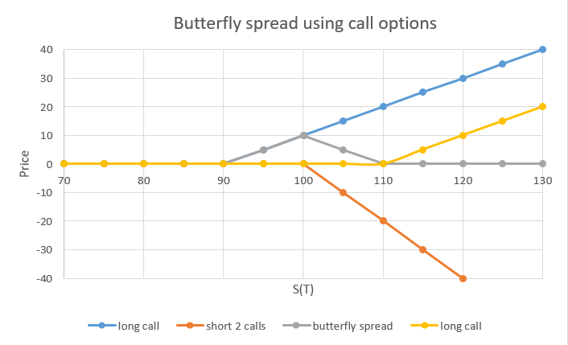
Payoff Diagram of Butterfly Spreads

Slide 20
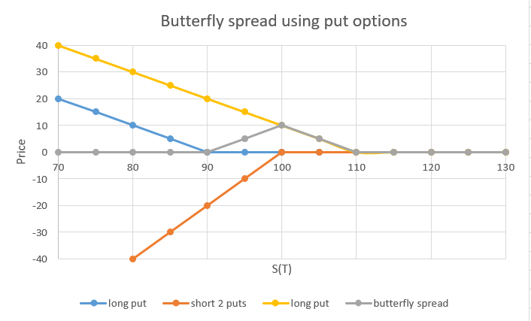
Payoff Diagram of Butterfly Spreads

Slide 21
Condor Spreads
Condor spreads is similar to the butterfly spreads except it involves 4 different strikes.
Like butterfly spreads, condor spreads is a short volatility strategy.
There are 4 strikes to specify a condor and can be constructed using calls or puts.
Using calls, the payoff of a condor spread:
Call(T,T,K1) – Call(T,T,K2) – Call(T,T,K3) + Call(T,T,K4)
K1<K2<K3<K4

Slide 22
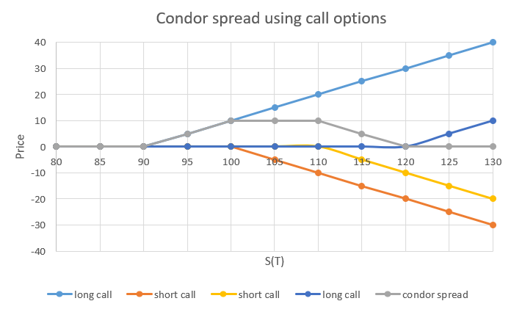
Payoff Diagram of Condor Spreads

Slide 23
Ratio Spreads
A generalization of bull or bear spreads.
The payoff of a ratio call spread is:
N1 * Call(T,T,K1) – N2 * Call(T,T,K2)
K1<K2, N1 and N2 are the numbers of Calls at K1 and K2 respectively.
Say N1=1, N2=2. The premium is lower than bull spreads for the same strikes because selling more calls.
Upside risk is not protected.

Slide 24
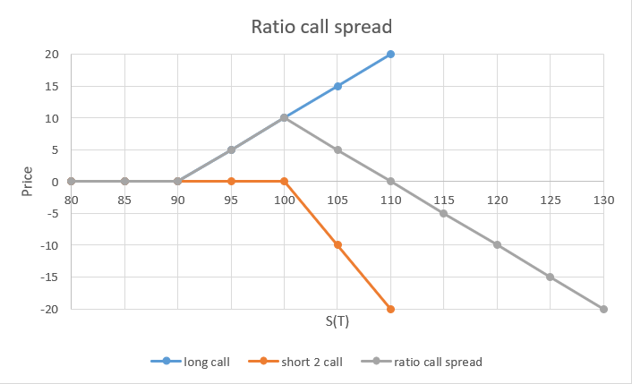
Ratio Call Spreads

Slide 25
Straddles
Straddles consist of long a call and a put on the same underlying at the same strike.
The payoff of a straddle is:
Call(T,T,K) + Put(T,T,K)
This is almost a pure volatility trade, i.e. no risk with respective to the underlying directional movement.
The delta of straddle is close to 0 as the call and put delta cancels each other but the vega is doubled.

Slide 26
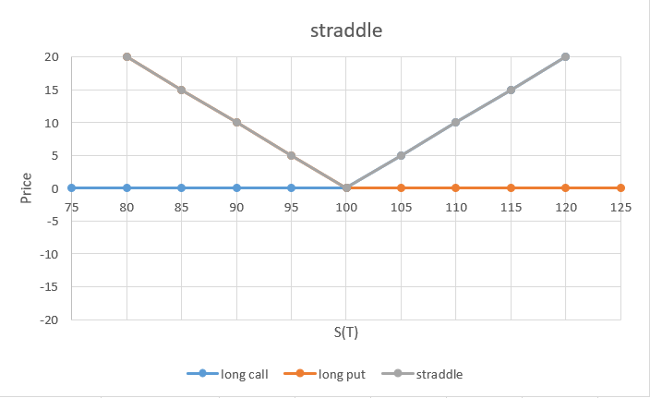
Straddles

Slide 27
Strangle
Strangle is a generalization of straddle with call and put are at different strikes.
The premium is cheaper than straddle.
The payoff of a strangle is:
Call(T,T,K1) + Put(T,T,K2)
K1<K2
The delta of straddle can be set to zero depends on the choice of strikes.
Vega is lower than straddle.

Slide 28
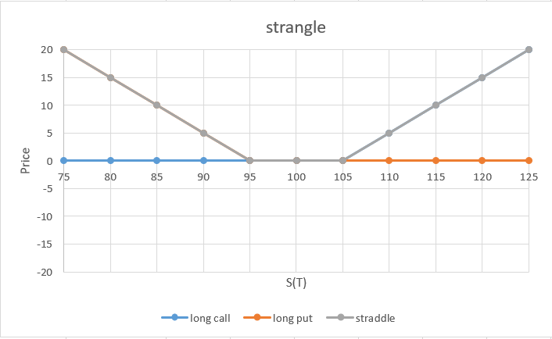
Strangle

Slide 29
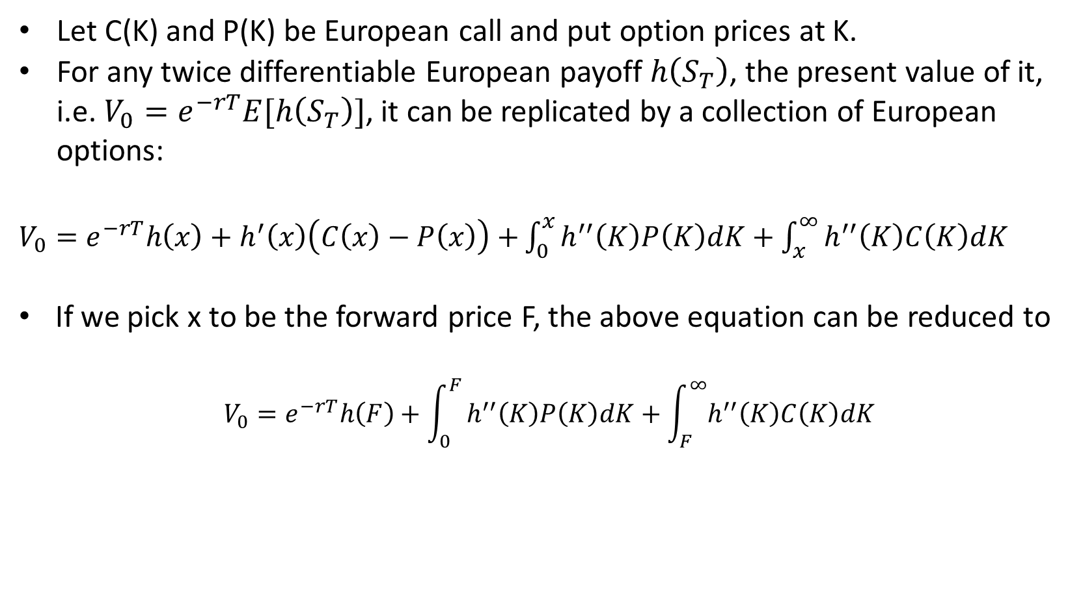
Breeden-Litzenberger Formula
Let C(K) and P(K) be European call and put option prices at K.
For any twice differentiable European payoff $h\left(S_{T}\right)$, the present value of it, i.e. $V_{0}=e^{−rT}E[h\left(S_{T}\right)]$, it can be replicated by a collection of European options:
$V_{0}=e^{−rT}h\left(x\right)+h^{′}\left(x\right)\left(C\left(x\right)−P\left(x\right)\right)$ $+\int_{0}^{x}{h^{′′}\left(K\right)P\left(K\right)dK+\int_{x}^{∞}{h^{′′}\left(K\right)C\left(K\right)dK}}$
If we pick x to be the forward price F, the above equation can be reduced to
$$V_{0}=e^{−rT}h\left(F\right)+\int_{0}^{F}{h^{′′}\left(K\right)P\left(K\right)dK+\int_{F}^{∞}{h^{′′}\left(K\right)C\left(K\right)dK}}$$

Slide 30
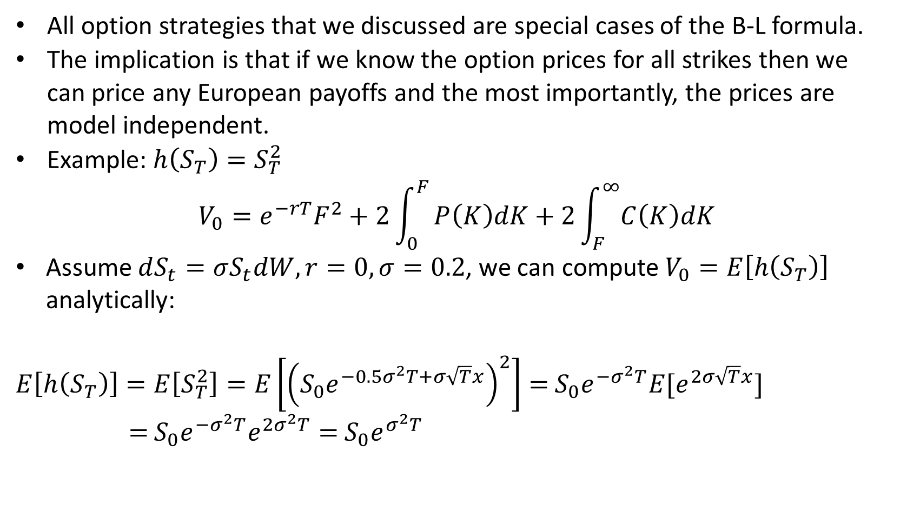
Breeden-Litzenberger Formula
All option strategies that we discussed are special cases of the B-L formula.
The implication is that if we know the option prices for all strikes then we can price any European payoffs and the most importantly, the prices are model independent.
Example: $h\left(S_{T}\right)=S_{T}^{2}$
$$V_{0}=e^{−rT}F^{2}+2\int_{0}^{F}{P\left(K\right)dK+2\int_{F}^{∞}{C\left(K\right)dK}}$$
Assume $dS_{t}=σS_{t}dW, r=0, σ=0.2$, we can compute $V_{0}=E\left[h\left(S_{T}\right)\right]$ analytically:
$E\left[h\left(S_{T}\right)\right]=E\left[S_{T}^{2}\right]=E\left[{\left(S_{0}e^{−0.5σ^{2}T+σ\sqrt{T}x}\right)}^{2}\right]=$ $S_{0}e^{−σ^{2}T}E[e^{2σ\sqrt{T}x}]$
$=$ $S_{0}e^{−σ^{2}T}e^{2σ^{2}T}=$ $S_{0}e^{σ^{2}T}$

Slide 31
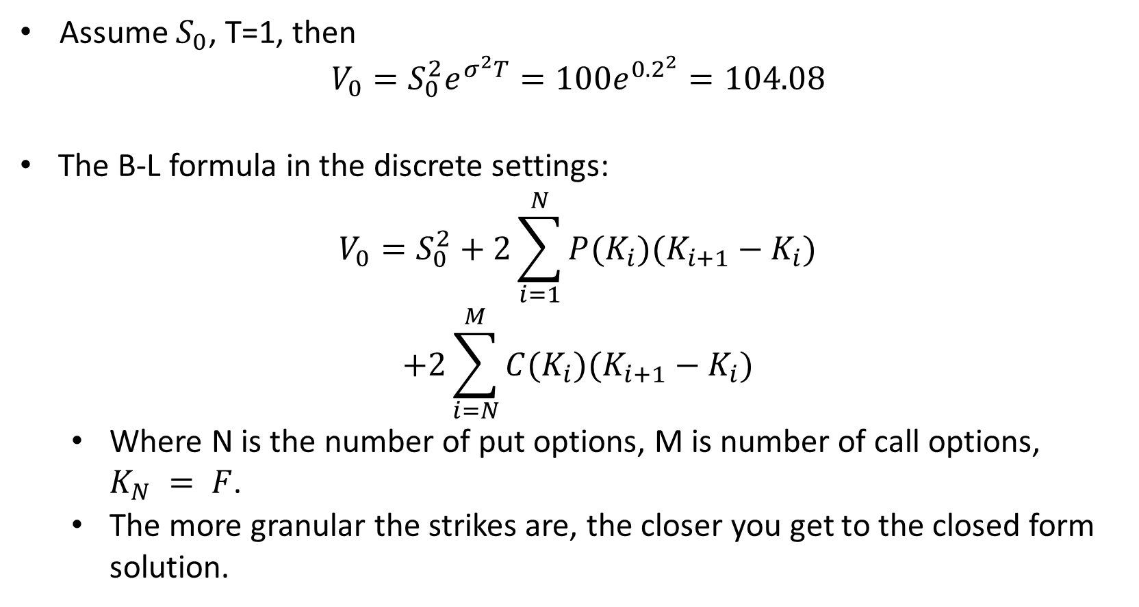
Breeden-Litzenberger Formula
Assume $S_{0}$, T=1, then
$$V_{0}=S_{0}^{2}e^{σ^{2}T}=100e^{{0.2}^{2}}=104.08$$
The B-L formula in the discrete settings:
$$V_{0}=S_{0}^{2}+2\sum_{i=1}^{N}{P(K_{i})(K_{i+1}−K_{i})}$$
$$+2\sum_{i=N}^{M}{C(K_{i})(K_{i+1}−K_{i})}$$
Where N is the number of put options, M is number of call options, $K_{N} = F$.
The more granular the strikes are, the closer you get to the closed form solution.

